Slide 1
Help Wanted Online A real-time measure of job postings
October 2021
Office of Research Connecticut Department of Labor
Connecticut Department of Labor – Research Office 200 Folly Brook Blvd. Wethersfield, CT 06109
Help Wanted Online

Slide 2
What is HWOL?
The Conference Board Help Wanted Online® Data Series (HWOL) measures the number of new, first-time Online job postings and jobs reposted from the previous month for over 50,000 Internet job boards, corporate boards and smaller job sites that serve niche markets and smaller geographic areas.
Connecticut Department of Labor – Research Office 200 Folly Brook Blvd. Wethersfield, CT 06109
Help Wanted Online

Slide 3
Upcoming Release Dates
Monthly Report: Friday, November 12th, 2021 Weekly New Ads Report: Updated every Friday
Connecticut Department of Labor – Research Office 200 Folly Brook Blvd. Wethersfield, CT 06109
Help Wanted Online

Slide 4
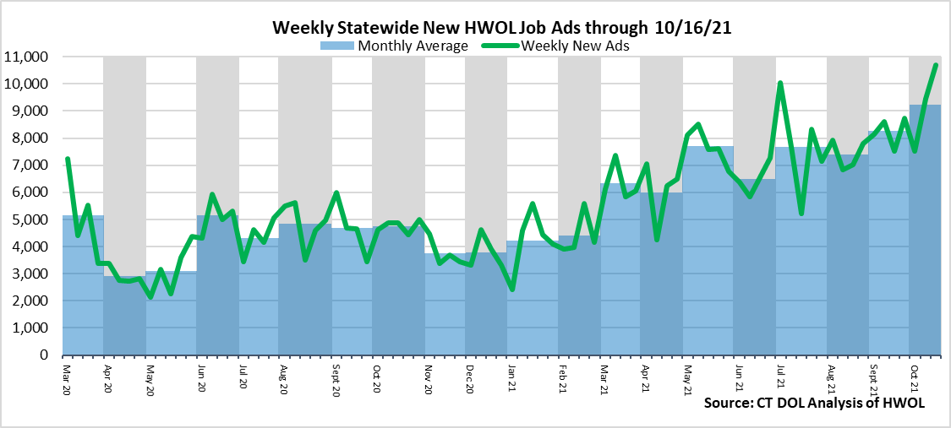
Statewide Weekly New Job Ads
Weekly New job postings were 10,690 during the week ending 10/16/21.
Connecticut Department of Labor – Research Office 200 Folly Brook Blvd. Wethersfield, CT 06109
Help Wanted Online

Slide 5
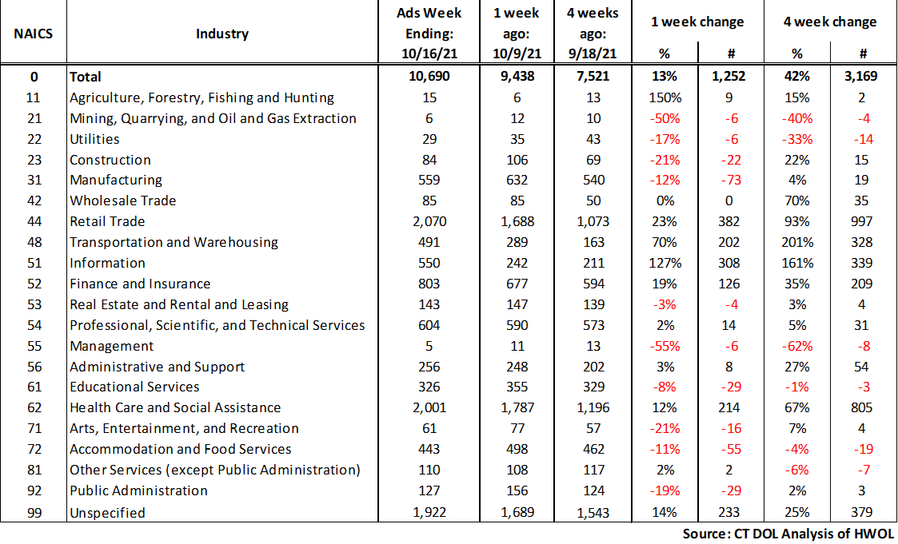
HWOL New Weekly Industry Job Ads – CT Statewide
Connecticut Department of Labor – Research Office 200 Folly Brook Blvd. Wethersfield, CT 06109
Help Wanted Online

Slide 6
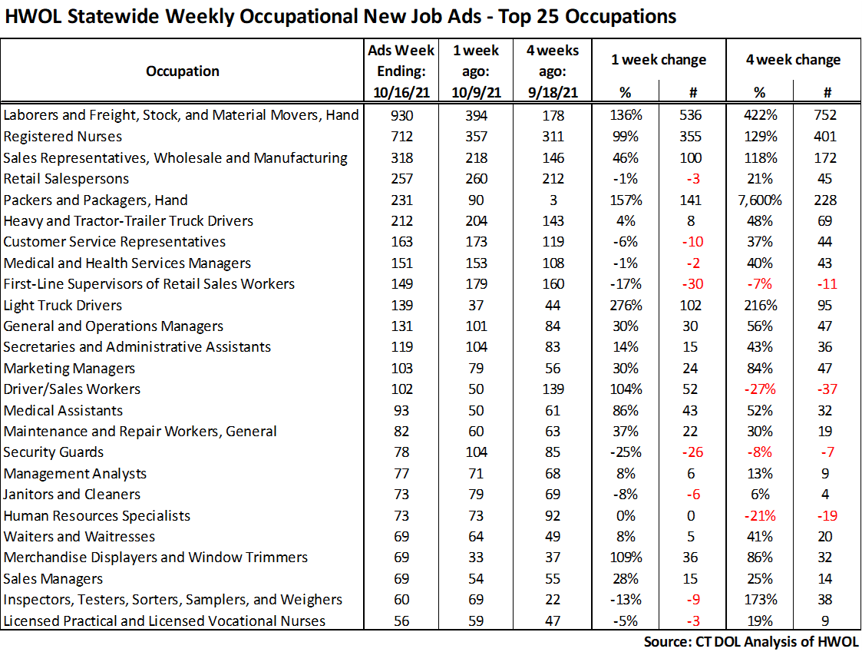
Connecticut Department of Labor – Research Office 200 Folly Brook Blvd. Wethersfield, CT 06109
Help Wanted Online

Slide 7
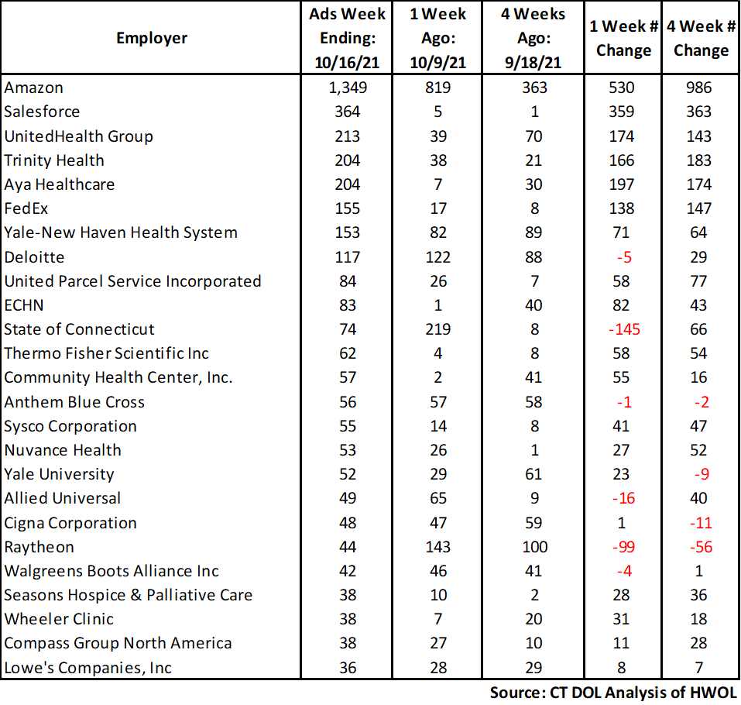
Employers with the Most New Job Postings
Connecticut Department of Labor – Research Office 200 Folly Brook Blvd. Wethersfield, CT 06109
Help Wanted Online

Slide 8
Monthly HWOL Information
The following pages contain HWOL monthly data for September 2021. Monthly and weekly job ad information can be found here: https://www1.ctdol.state.ct.us/lmi/HWOL.asp
Connecticut Department of Labor – Research Office 200 Folly Brook Blvd. Wethersfield, CT 06109
Help Wanted Online

Slide 9
Statewide Highlights
- Total postings in Connecticut was 94,428 in September 2021. -Industry sectors with the most job postings were Health Care and Social Assistance (17,038 postings), Retail Trade (15,195 postings), Finance and Insurance (7,500 posting), and Professional, Scientific, and Technical Services (6,221 postings).
-Occupations with the most postings were Registered Nurses (4,016 postings), Laborers & Freight, Stock, and Material Movers (3,270 postings), Retail Salespersons (3,228 postings), Supervisors of Retail Sales Workers (2,198 postings) and Wholesale and Manufacturing Sales Representatives (2,098 postings).
Connecticut Department of Labor – Research Office 200 Folly Brook Blvd. Wethersfield, CT 06109
Help Wanted Online

Slide 10
Connecticut Job Ads by Educational Requirements
Connecticut Department of Labor – Research Office 200 Folly Brook Blvd. Wethersfield, CT 06109
Help Wanted Online

Slide 11
Top Certifications in Connecticut Job Ads
Connecticut Department of Labor – Research Office 200 Folly Brook Blvd. Wethersfield, CT 06109
Help Wanted Online

Slide 12
Top Skills in Connecticut Job Ads
Connecticut Department of Labor – Research Office 200 Folly Brook Blvd. Wethersfield, CT 06109
Help Wanted Online

Slide 13
Top Skills by Industry in Connecticut Job Ads
Connecticut Department of Labor – Research Office 200 Folly Brook Blvd. Wethersfield, CT 06109
Help Wanted Online

Slide 14
Top Skills by Industry in Connecticut Job Ads (Continued)
Connecticut Department of Labor – Research Office 200 Folly Brook Blvd. Wethersfield, CT 06109
Help Wanted Online

Slide 15
Connecticut Department of Labor – Research Office 200 Folly Brook Blvd. Wethersfield, CT 06109
Help Wanted Online

Slide 16
Connecticut Employers with the Most Job Ads
Connecticut Department of Labor – Research Office 200 Folly Brook Blvd. Wethersfield, CT 06109
Help Wanted Online

Slide 17
Connecticut Occupations with the Most Job Ads
Connecticut Department of Labor – Research Office 200 Folly Brook Blvd. Wethersfield, CT 06109
Help Wanted Online

Slide 18
Connecticut Job Ads by Industry and Major Occupational Group
Connecticut Department of Labor – Research Office 200 Folly Brook Blvd. Wethersfield, CT 06109
Help Wanted Online

Slide 19
Workforce Area Data
Workforce Area Highlights
Job Ads by Industry
Job Ads by Location
Employers With The Most Job Ads
Occupations With The Most Job Ads
Connecticut Department of Labor – Research Office 200 Folly Brook Blvd. Wethersfield, CT 06109
Help Wanted Online

Slide 20
Workforce Area Highlights
Connecticut Department of Labor – Research Office 200 Folly Brook Blvd. Wethersfield, CT 06109
Help Wanted Online

Slide 21
Connecticut Department of Labor – Research Office 200 Folly Brook Blvd. Wethersfield, CT 06109
Help Wanted Online

Slide 22
Eastern Workforce Job Ads by Location
Connecticut Department of Labor – Research Office 200 Folly Brook Blvd. Wethersfield, CT 06109
Help Wanted Online

Slide 23
Eastern Workforce Employers
with the Most Job Ads
University of Connecticut
Mohegan Sun
Compass Group North America
Day Kimball Healthcare
Advantage Sales & Marketing
Groton Public Schools
Windham Hospital
Petco
Hyatt
US Foods
Mashantucket Pequot Gaming
Reliance Health Group
Nordson Corporation
Allied Universal
Dunkin' Donuts
Thames Valley Council For Community Action, Inc
Three Rivers Community College
Norwich Public Schools
Hartford Healthcare
Amazon
Yale-New Haven Health System
Pfizer
General Dynamics
Lowe's Companies, Inc
Walmart / Sam's
Walgreens Boots Alliance Inc
United Services Incorporated
State of Connecticut
Staples
Masonicare Corporation
Thames Valley Council For Community Action
United Community Family Services Incorporated
Sonalysts Incorporated
Asplundh Tree Expert Company
CVS Health
Coast Guard Community Services Command
Hersha Hospitality Management Lp
Connecticut Department of Labor – Research Office 200 Folly Brook Blvd. Wethersfield, CT 06109
Help Wanted Online

Slide 24
Eastern Workforce Occupations
with the Most Job Ads
Connecticut Department of Labor – Research Office 200 Folly Brook Blvd. Wethersfield, CT 06109
Help Wanted Online

Slide 25
Connecticut Department of Labor – Research Office 200 Folly Brook Blvd. Wethersfield, CT 06109
Help Wanted Online
25

Slide 26
North Central WDA Job Ads by Location
Connecticut Department of Labor – Research Office 200 Folly Brook Blvd. Wethersfield, CT 06109
Help Wanted Online

Slide 27
North Central WDA Employers
with the Most Job Ads
Raytheon
Hartford Healthcare
Accenture
Travelers
The Hartford Financial Group
Advantage Sales & Marketing
Allied Universal
Stanley Black & Decker
Disney
Pearson
Pratt & Whitney
Whole Foods Market, Inc.
Guidehouse
Eastern Connecticut Health Network
Advance Auto Parts Incorporated
Petco
Trinity Health Of New England
Walmart / Sam's
University of Connecticut
Amazon
Cigna Corporation
UnitedHealth Group
Deloitte
CVS Health
Connecticut Children's Medical Center
ECHN
ICF
Boston Market
State of Connecticut
Nelnet
Trinity Health
Mercy Medical Center Clinton
Aya Healthcare
Wheeler Clinic
Capitol Region Education Council
Cognizant Technology
Ryder System Incorporated
The Home Depot Incorporated
Connecticut Department of Labor – Research Office 200 Folly Brook Blvd. Wethersfield, CT 06109
Help Wanted Online

Slide 28
North Central WDA Occupations
with the Most Job Ads
Connecticut Department of Labor – Research Office 200 Folly Brook Blvd. Wethersfield, CT 06109
Help Wanted Online

Slide 29
Connecticut Department of Labor – Research Office 200 Folly Brook Blvd. Wethersfield, CT 06109
Help Wanted Online

Slide 30
Northwest WDA Job Ads by Location
Connecticut Department of Labor – Research Office 200 Folly Brook Blvd. Wethersfield, CT 06109
Help Wanted Online

Slide 31
Northwest WDA Employers
with the Most Job Ads
Amazon
Nuvance Health
Hartford Healthcare
Boehringer Ingelheim
Compass Group North America
Macy's
The Home Depot Incorporated
UnitedHealth Group
Naugatuck Public Schools
Benchmark Senior Living
Mercy Medical Center Clinton
CVS Health
Genesis Healthcare Corporation
Trinity Health
Advance Auto Parts Incorporated
Trugreen
Realogy Franchise Group LLC
Danbury Public Schools
Seasons Hospice & Palliative Care
Waterbury Hospital
Advantage Sales & Marketing
Petco
Aya Healthcare
Trinity Health Of New England
BJ's Wholesale Club, Inc.
Stop Shop Supermarket
Walgreens Boots Alliance Inc
Whole Foods Market, Inc.
Walmart / Sam's
IBM
Charlotte Hungerford Hospital
Post University
Edadvance
YMCA
TJX Companies, Inc.
Allied Universal
LHC Group
YRC Freight
Connecticut Department of Labor – Research Office 200 Folly Brook Blvd. Wethersfield, CT 06109
Help Wanted Online

Slide 32
Northwest WDA Occupations
with the Most Job Ads
Connecticut Department of Labor – Research Office 200 Folly Brook Blvd. Wethersfield, CT 06109
Help Wanted Online

Slide 33
Connecticut Department of Labor – Research Office 200 Folly Brook Blvd. Wethersfield, CT 06109
Help Wanted Online

Slide 34
South Central WDA Job Ads by Location
Connecticut Department of Labor – Research Office 200 Folly Brook Blvd. Wethersfield, CT 06109
Help Wanted Online

Slide 35
South Central WDA Employers
with the Most Job Ads
Amazon
Yale-New Haven Health System
Yale University
Advantage Sales & Marketing
Masonicare Corporation
Walgreens Boots Alliance Inc
Allied Universal
Raytheon
UnitedHealth Group
Lowe's Companies, Inc
Quest Diagnostics Incorporated
Actalent
Genesis Healthcare Corporation
Compass Group North America
State of Connecticut
TJX Companies, Inc.
The Home Depot Incorporated
Aya Healthcare
Burlington Stores
Anthem Blue Cross
Hartford Healthcare
Medtronic
Petco
Community Health Center, Inc.
Middlesex Health System Incorporated
Department of Veterans Affairs
St Vincent’s Medical Center
Honeywell
Walmart / Sam's
Wesleyan University
A R Mazzotta Employment
Boston Market
Benchmark Senior Living
O'Reilly Automotive Inc
Avangrid
YMCA
Advance Auto Parts Incorporated
Quinnipiac University
Connecticut Department of Labor – Research Office 200 Folly Brook Blvd. Wethersfield, CT 06109
Help Wanted Online

Slide 36
South Central WDA Occupations
with the Most Job Ads
Connecticut Department of Labor – Research Office 200 Folly Brook Blvd. Wethersfield, CT 06109
Help Wanted Online

Slide 37
Connecticut Department of Labor – Research Office 200 Folly Brook Blvd. Wethersfield, CT 06109
Help Wanted Online

Slide 38
Southwest WDA Job Ads by Location
Connecticut Department of Labor – Research Office 200 Folly Brook Blvd. Wethersfield, CT 06109
Help Wanted Online

Slide 39
Southwest WDA Employers
with the Most Job Ads
Deloitte
Charter Communications
Stamford Hospital
Whole Foods Market, Inc.
Gartner Incorporated
Lockheed Martin Corporation
Norwalk Public School District
KPMG
Sema4
Norwalk Public Schools
Hartford Healthcare
St. Vincent's Health Service
Aya Healthcare
Boston Market
Rolls Royce Plc
Thermo Fisher Scientific Inc
The Home Depot Incorporated
XPO Logistics
World Wrestling Entertainment
Amazon
Humana
Yale-New Haven Health System
Compass Group North America
St Vincent’s Medical Center
Advantage Sales & Marketing
Allied Universal
Synchrony
Circle Internet Financial Limited
NBC
Griffin Health
Sacred Heart University
Petco
M&T Bank
ASML United States Incorporated
CVS Health
Griffin Hospital
UnitedHealth Group
Apple Inc.
Connecticut Department of Labor – Research Office 200 Folly Brook Blvd. Wethersfield, CT 06109
Help Wanted Online

Slide 40
Southwest WDA Occupations
with the Most Job Ads
Connecticut Department of Labor – Research Office 200 Folly Brook Blvd. Wethersfield, CT 06109
Help Wanted Online

Slide 41
All advertisement data used in this publication is from the Conference Board’s Help Wanted Online data series.
For more information or data requests, contact Matthew Krzyzek in the Office of Research at the Department of Labor.
Matthew.Krzyzek@ct.gov
For more Connecticut Labor Market Information visit:
www.ctdol.state.ct.us/lmi
https://www.facebook.com/ctlmi
Twitter: @DOL_Research
Connecticut Department of Labor – Research Office 200 Folly Brook Blvd. Wethersfield, CT 06109
Help Wanted Online

